Slide 1
Automatic Indexing
Indexing
Term selection and weight assignment
Conflation/Stemming
Thesaurus and phrases
References:
  Salton89, Chapter 9.7
  Baeza-Yates and Ribeiro-Neto Chapter 7.2.5
COMP 336 Dik Lun LEE Department of Computer Science, HKUST, Slide <number>

Slide 2
Helping Query Formulation
Most users cannot formulate query keywords to find good results
User’s vocabulary is different from that used by the document authors
  Causing terminology mismatch because search is based on keyword match, not based on concepts and meanings of the keywords
But how do we know the concepts and meanings of a word (or a sequence of words)???
COMP 336 Dik Lun LEE Department of Computer Science, HKUST, Slide <number>

Slide 3
Dictionary
Dictionary explains the meaning of a word, presumably to be read by human users.
Dictionary entry (www.dictionary.com):
  cow·ard·ly
  – adjective
  lacking courage; contemptibly timid.
  characteristic of or befitting a coward; despicably mean, covert, or unprincipled: a cowardly attack on a weak, defenseless man.
  – adverb
  3. like a coward.
COMP 336 Dik Lun LEE Department of Computer Science, HKUST, Slide <number>

Slide 4
What is a Thesaurus?
Like a dictionary
  It may contain all the words in a language or just important words in a particular domain (e.g., finance, computer science)
A thesaurus aims at providing:
  Classification of words in a language
  Given a word, it gives related terms which are
    broader than
    narrower than
    same as (synonyms) and
    opposed to (antonyms)
  Other kinds of relationships, e.g., composed of
COMP 336 Dik Lun LEE Department of Computer Science, HKUST, Slide <number>

Slide 5
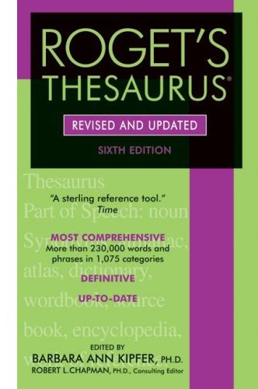
Roget's Thesaurus (1911)
Express relationships between English words and classify words into 6 broad classes:
  abstract relations, space, matter, intellect, volition (will), affection
Very popular; more for language users, writers, etc.
II. PERSONAL AFFECTIONS
  3. Prospective (of future) Affections
  [Adjectives] coward, cowardly; fearful; …
An interesting link:
http://www.voycabulary.com
COMP 336 Dik Lun LEE Department of Computer Science, HKUST, Slide <number>

Slide 6
Top Levels of Roget's Taxonomy
CLASS I: WORDS EXPRESSING ABSTRACT RELATIONS
  SECTION I. EXISTENCE
  SECTION II. RELATION
  SECTION III. QUANTITY
  SECTION IV. ORDER
  SECTION V. NUMBER
  SECTION VI. TIME
  SECTION VII. CHANGE
  SECTION VIII. CAUSATION
CLASS II: WORDS RELATING TO SPACE
  SECTION I. SPACE IN GENERAL
  SECTION II. DIMENSIONS
  SECTION III. FORM
  SECTION IV. MOTION
CLASS III: WORDS RELATING TO MATTER
  SECTION I. MATTER IN GENERAL
  SECTION II. INORGANIC MATTER
  SECTION III. ORGANIC MATTER
CLASS IV: WORDS RELATING TO THE INTELLECTUAL FACULTIES
  DIVISION I: FORMATION OF IDEAS
  DIVISION II: COMMUNICATION OF IDEAS
CLASS V: WORDS RELATING TO THE VOLUNTARY POWERS
  DIVISION I: INDIVIDUAL VOLITION
  DIVISION II: INTERSOCIAL VOLITION
CLASS VI: WORDS RELATING TO THE SENTIMENT AND MORAL POWER
  SECTION I. AFFECTIONS IN GENERAL
  SECTION II. PERSONAL AFFECTIONS
  SECTION III. SYMPATHETIC AFFECTIONS
  SECTION IV. MORAL AFFECTIONS
  SECTION V. RELIGIOUS AFFECTIONS
http://www.cs.utexas.edu/users/kbarker/working_notes/roget-taxo.html
COMP 336 Dik Lun LEE Department of Computer Science, HKUST, Slide <number>

Slide 7
Following a Path in Roget's Taxonomy
CLASS I: WORDS EXPRESSING ABSTRACT RELATIONS
  SECTION I. EXISTENCE
    1. BEING, IN THE ABSTRACT
      #1. Existence.
      #2. Inexistence.
    2. BEING, IN THE CONCRETE
      #3. Substantiality.
#1, #2, #3, etc., are headwords, naming groups of related words
#3. Substantiality. -- N. substantiality, hypostasis; person, being, thing, object, article, item; something, a being, an existence; creature, body, substance, flesh and blood, stuff , substratum; matter &c. 316; corporeity[obs3], element, essential nature, groundwork, materiality, substantialness, vital part.
[Totality of existences], world &c. 318; plenum.
Adj. substantive, substantial; hypostatic; personal, bodily, tangible &c. (material) 316; corporeal.
Adv. substantially &c. adj.; bodily, essentially.
Paragraphs (or paragraph group): words with the same part of speech and semantically related.
COMP 336 Dik Lun LEE Department of Computer Science, HKUST, Slide <number>

Slide 8
An Entry in Roget's New Millennium™ Thesaurus
Main Entry: cowardly
Part of Speech: adverb
Definition: fearful
Synonyms: afraid, anxious, apprehensive, backward, base, caitiff, cowering, cowhearted, craven, dastardly, diffident, dismayed, faint-hearted, frightened, gutless, jittery, lacking courage, lily-livered, nervous, no guts, panicky, paper tiger, pigeon-hearted, pusillanimous, recreant, retiring, run scared, scared, shrinking, shy, soft, spineless, the willies, timid, timorous, unmanly, weak, weak-kneed, worthless, yellow
Antonyms: bold, brave, courageous, daring, dauntless, gutsy, unafraid
COMP 336 Dik Lun LEE Department of Computer Science, HKUST, Slide <number>

Slide 9
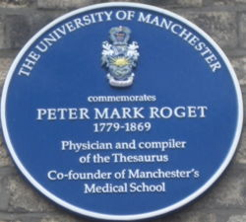
How was the Thesaurus created?
Fairly large hierarchy (still much smaller than a modern dictionary)
  original (1852) edition contained 15000 words
  1911 version added 1000 words
Classifying words according to semantics
No help from modern technology
Took nearly 50 years to develop
(started in 1805 and public release in 1852)
COMP 336 Dik Lun LEE Department of Computer Science, HKUST, Slide <number>

Slide 10
Uses of a Thesaurus
Provide a standard vocabulary for indexing and searching
Help users to find terms for proper query formulation
  Helpful for users to navigate from one collection to another with different subjects
Provide classified hierarchies that allow broadening and narrowing of query terms
General thesauri are too general to be useful in IR
  No technical terms (what is ipod?)
  Complex concepts (a “marble dining table” instead of just “table”)
COMP 336 Dik Lun LEE Department of Computer Science, HKUST, Slide <number>

Slide 11
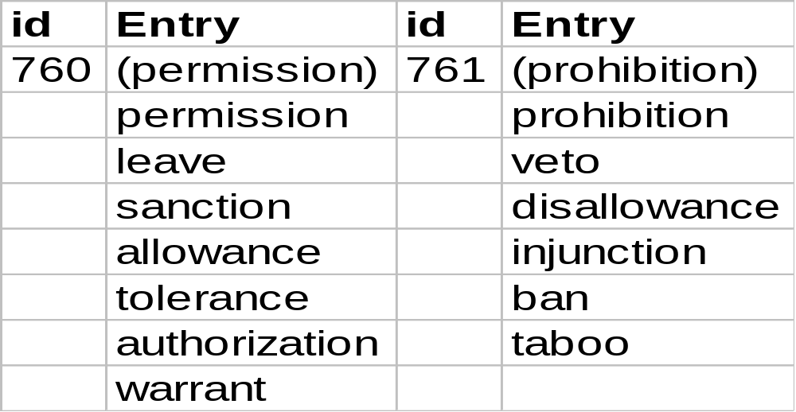
Thesaurus Group
Thesaurus can be used to broaden the scope of a term, hence to improve recall.
Convert every term within the same class to the id of the class:
COMP 336 Dik Lun LEE Department of Computer Science, HKUST, Slide <number>

Slide 12
Thesaurus Construction
Stemming can be applied at the same time to reduce the size of thesaurus
Thesaurus can be constructed either manually (e.g., Roget’s thesaurus) or automatically. Issues are
  what terms should be included in the thesaurus
  the terms specified for inclusion must be suitably grouped
COMP 336 Dik Lun LEE Department of Computer Science, HKUST, Slide <number>

Slide 13
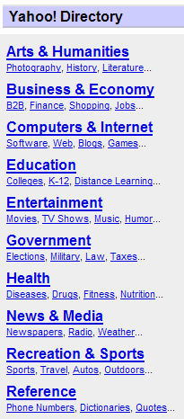
Taxonomy
Much like thesaurus in terms of classifying and relating “things”
  Thesaurus deals with single words and is universal for a language
  Taxonomy deals with “concepts” and is specific to an application
Yahoo! Directory (dir.yahoo.com)
Open Directory Project (www.dmoz.org)
A particular field (e.g., medical science) or an organization has its own taxonomy
COMP 336 Dik Lun LEE Department of Computer Science, HKUST, Slide <number>

Slide 14
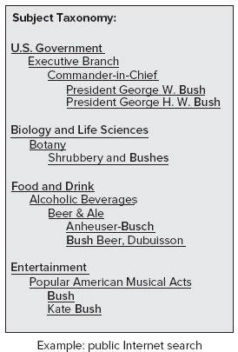
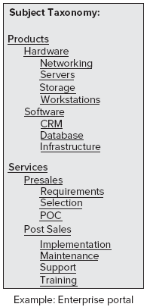
Subject-Based Taxonomy
Corresponding to how things are organized in an organization
  Think about how a company’s website is organized: Departments, products, services, etc.
COMP 336 Dik Lun LEE Department of Computer Science, HKUST, Slide <number>

Slide 15
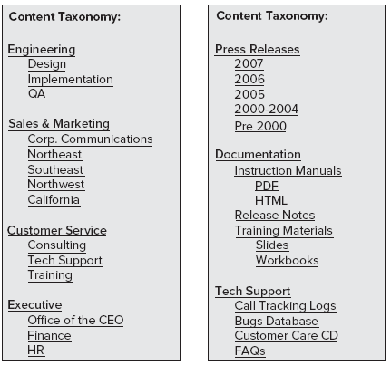
Content-Based Taxonomy
Contents do not always correspond to real world organizations
Contents are more abstract
than departments and
products
Think of organizing all of the
documents in an organization
based on their contents, not
by who owns the documents
COMP 336 Dik Lun LEE Department of Computer Science, HKUST, Slide <number>

Slide 16
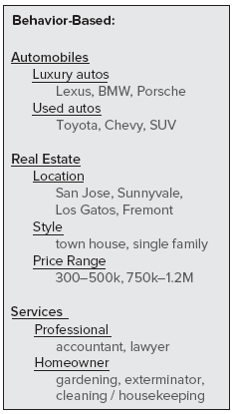
Behavior-Based Taxonomy
What is shown on the taxonomy depends on how often they were accessed by users
In the example, maybe the first
two levels are fixed, but the lowest
level is dynamically generated
COMP 336 Dik Lun LEE Department of Computer Science, HKUST, Slide <number>

Slide 17
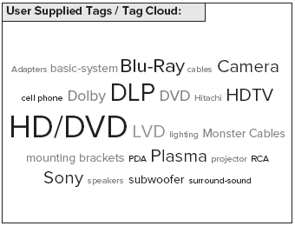
Tag-Cloud: Visualization of Taxonomy
The nodes could be dynamic, e.g., tags enters by authors and viewers, which are unpredictable
Could be a combination of content-based and behavior-based taxonomy: Each page has pre-defined content keywords and what are shown (and their sizes) depends on access frequencies
COMP 336 Dik Lun LEE Department of Computer Science, HKUST, Slide <number>

Slide 18
Ontology
Compared to taxonomy, ontology contains more refined and application-independent concepts (i.e., describe the world)
Billiard Game
Meaning ID 1265
Define concepts and relationships among concepts
The word “pool” have different meanings:
  As in “swimming pool”
  As in “billiard game”
  As in “puddle”
The meanings can be disambiguated by the related concepts
  What does “pool” mean in “I like the pool and hot tub in the hotel.”
Swimming Pool
Meaning ID 7099
Diving board
Meaning ID 7081
Cue Stick
Meaning ID 1267
Hot Tub
Meaning ID 7141
Rainwater
Meaning ID 4961
Puddle
Meaning ID 458
COMP 336 Dik Lun LEE Department of Computer Science, HKUST, Slide <number>

Slide 19
Companies - Applied Semantics
Applied Semantics, started in 1998, owned CIRCA (Conceptual Information Retrieval and Communication Architecture) ontology
  Contains 500,000 concepts and relationships among concepts
  Linguistic Processing Engine to categorize, summarize and keyword-tag unstructured information
Acquired by Google in 2003 (before Google launched “adsense”)
Some businesses before acquisition:
  Partnered with domain name registrars to suggest good domain name alternatives to customers who want to buy domain names
    E.g., if “mymoney.com” is taken, suggest “personalinvest.com”
  Display targeted ads (then partnered with Overture) for parked domain names by analyzing the “meanings” of the domain names
COMP 336 Dik Lun LEE Department of Computer Science, HKUST, Slide <number>

Slide 20
Applied Semantics
Drives Google “Adsense” products after Google acquisition
  Processes the actual content of Web pages
  Uses its CIRCA ontology to understand and extract key themes of a page
  Disambiguate ambiguous terms
  Use the context to deliver relevant advertisements for the page
COMP 336 Dik Lun LEE Department of Computer Science, HKUST, Slide <number>

Slide 21
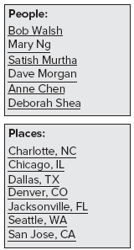
Challenges
Defining taxonomy and ontology is difficult enough, but assigned documents to taxonomy and ontology nodes are even more difficult
  By hand? By rule? By machine learning (e.g., automatic clustering)
  Automatic named entity extraction (e.g., person and
  company names), e.g., named entities extracted from
  the search results are shown
How to identify different meanings of the same word?
  “pool” should be identified as “pool-1” for swimming pools, “pool-2” for billiard games, and “pool-3” for … … in an ontology
  See the “Boston” example in Metaweb video (course topic page)
COMP 336 Dik Lun LEE Department of Computer Science, HKUST, Slide <number>

Slide 22
Summary
 | Dictionary | Thesaurus | Taxonomy | Ontology
“End” Users | People | People / Machine | People / Machine | Machine
Knowledge Granularity | Single words | Single words | High-level subjects | Fine to high-level concepts
Hierarchy | - | Tree + relations between words | Tree + cross links between subjects | Graph
Applications | Linguistics | Linguistics | Web | Web / AI
COMP 336 Dik Lun LEE Department of Computer Science, HKUST, Slide <number>

Slide 23
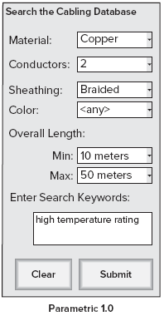
Faceted and Parametric Search
Taxonomy, faceted and parametric searches are very similar (same thing invented by different people)
  Data have multiple attributes (facets)
  User can restrict search by selecting the facet
  categories on the advanced search interface
  Unfortunately, users rarely use the advanced
  search interface (did you use Google’s advanced
  search?)
COMP 336 Dik Lun LEE Department of Computer Science, HKUST, Slide <number>

Slide 24
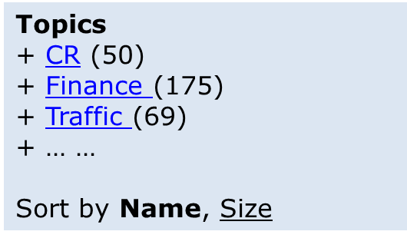
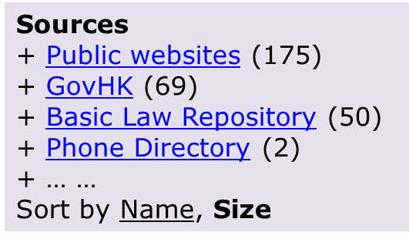
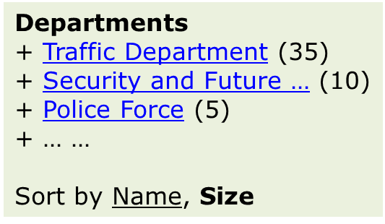
Taxonomy Search
Search result is a linear list of pages; there is no apparent relationships between the pages other than ranking
Taxonomy provides a semantic map of the results; search “regulation” results are mapped on taxonomies
SE
Taxonomies
Search results
Number of results under the topic; click to see results
COMP 336 Dik Lun LEE Department of Computer Science, HKUST, Slide <number>

Slide 25
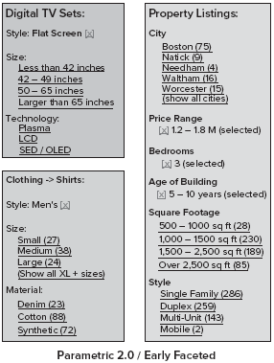
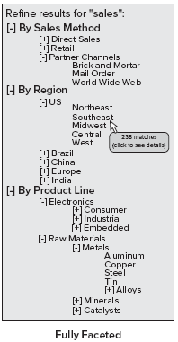
Faceted and Parametric Search (cont.)
Better design: user performs a general search (no facet) first
Then, search results are presented together with relevant facets
Simpler:
One level
Non-expandable or shrinkable
COMP 336 Dik Lun LEE Department of Computer Science, HKUST, Slide <number>

Slide 26
Wordnet
– A Lexical Database –
– Linguistic Ontology –
COMP 336 Dik Lun LEE Department of Computer Science, HKUST, Slide <number>

Slide 27
Wordnet
Developed at Princeton University
  Started in 1985 with initial funding from DARPA
  http://wordnet.princeton.edu
As of 2006, Wordnet contains about 150,000 words organized in over 115,000 synsets for a total of 207,000 word-sense pairs
  In compressed form, it is about 12 megabytes in size.
Both software and database can be downloaded (BSD lincense)
COMP 336 Dik Lun LEE Department of Computer Science, HKUST, Slide <number>

Slide 28
Wordnet – Synset (Synonym Set)
Word meanings are represented synsets
A synset represents a meaning that may be independently named by different words
  @(NOUN.COGNITION “example” “instance” “illustration” “representative”)
  @(VERB.COGNITION “read” “take” “learn” “study”)
Note: a synset does not describe the meaning as a dictionary does
synonyms
Wordnet 1.7: Noun hierarchy has 9 top level and 161 second-level categories
Top level hierarchy:
Nouns: thing, entity | process, … | cognition … | … |
Verbs: bodily function …| social interaction … | cognition … | …
Adjectives: descriptive … | color … | relational … |
COMP 336 Dik Lun LEE Department of Computer Science, HKUST, Slide <number>

Slide 29
How to Discover Synsets?
Two words are assigned to the same synset if:
“There exist a set of sentences in which these words can be substituted for each other without significant loss of meaning.”
Wordnet is a typical example of an ontology
Wordnet is a typical instance of an ontology
synset
Synsets must be created by human
COMP 336 Dik Lun LEE Department of Computer Science, HKUST, Slide <number>

Slide 30
Hypernymy/Hyponymy Relation
Hypernymy/Hyponymy: generalization/specialization relationship
Specialization, hyponymy and ISA (is-a) relations are the same
Dessert
hypernym-of
hyponym-of
Specialization
Generalization
Pie
Cake
“Dessert” is a generalization of “Cake”
  => “Cake” is hyponym of “Dessert”
  => “Dessert” is a Hypernym of “Cake”
COMP 336 Dik Lun LEE Department of Computer Science, HKUST, Slide <number>

Slide 31
Hypernymy/Hyponymy Relation
Different Hypernym and Hyponym relationships can be established for different word senses
@(NOUN.COGNITION “information”)
hyponym-of
@(NOUN.COGNITION “example” “instance” “illustration” “representative”)
@(NOUN.EVENT “occurrence” “happening” (“natural” “event”) )
hyponym-of
@(NOUN.EVENT “case” “example” “instance”)
COMP 336 Dik Lun LEE Department of Computer Science, HKUST, Slide <number>

Slide 32
Meronymy/Holonymy Relation
Meronymy, part-whole, aggregation, composition relations are the same
Spaghetti with meatballs
Holonymy
meronymy
meronymy-of / parts-of
Spaghetti
Meatball
Tomato sauce
Spaghetti is parts-of “Spaghetti with meatballs”
  => “Spaghetti” is meronym of “Spaghetti with meatballs”
  => “Spaghetti with meatballs” is a holonym of “Spaghetti”
COMP 336 Dik Lun LEE Department of Computer Science, HKUST, Slide <number>

Slide 33
Meronymy/Holonymy Relation
With word senses attached
@(NOUN.ARTIFACT (“phone’ “system”) (“telephone” “system”)
meronymy-of / parts-of
@(NOUN.ARTIFACT “line” “cable”)
@(NOUN.ARTIFACT “telephone” “phone” (“telephone” “set”) )
meronymy-of /parts-of
@(NOUN.ARTIFACT “mouthpiece”)
@(NOUN.ARTIFACT (“telephone” “receiver”) “receiver”)
COMP 336 Dik Lun LEE Department of Computer Science, HKUST, Slide <number>

Slide 34
Other Relationships between Synsets
Two other kinds of part-whole relationships”
  Stuff-of/ingredients
    sand is the stuff-of beaches
  Member-of/members
    professor is a member of a faculty
Antonymy – opposite of synonymy
COMP 336 Dik Lun LEE Department of Computer Science, HKUST, Slide <number>

Slide 35
Other Wordnet Projects
Wordnet is mainly for American and British English
Other languages:
  Euro Wordnet
    Funded by EU and completed in 1999
  Chinese Wordnet
    Beijing University, National Taiwan University (2002)
  Japanese Wordnet
    http://www.freshports.org/japanese/wordnet-fpw (2005)
COMP 336 Dik Lun LEE Department of Computer Science, HKUST, Slide <number>

Slide 36
Domain Ontologies
Library of Congress Subject Headings (LCSH)
  Most commonly used controlled vocabulary for libraries
Dewey Decimal Classification (DDC)
  Used by library and online information services (newsfeeds)
United Nations Educational, Scientific and Cultural Organization (UNESCO)
United Nations Standard Products and Services Codes (UNSPSC)
North American Industry Classification System (NAICS)
OpenGalen: Clinical terminology represented in the medical-oriented language GRAIL
UMLS (Unified Medical Language System) developed by US National Library of Medicine for biomedical terms
COMP 336 Dik Lun LEE Department of Computer Science, HKUST, Slide <number>

Slide 37
What Have We Learned?
Surprise! We studied a main branch of AI: knowledge representation
But we are looking from a linguistics point of view
  How words are formed (morphological analysis, and stemming is a quick-and-dirty morphological algorithm)
  The meanings of words
    Dictionaries
    Thesaurus and Wordnet: Understanding words by their association with other words
  The meanings of higher-level concepts
    Taxonomy and ontology: Not only deal with single words, but higher-level concepts like “hot bath”, “mutual funds”
Big question: How do we use these linguistic tools in search engines?
COMP 336 Dik Lun LEE Department of Computer Science, HKUST, Slide <number>

Slide 38
What Have We Learnt?
Dictionary, thesaurus, taxonomy and ontology all aim at universality, but statistical analysis is based on a corpus
If it is true in the (well chosen, large enough) corpus, it must be roughly true in general
  Word frequencies
  Collocation and co-occurrences
  Bigrams (pairs of words) and frequencies of bigrams to derive “meaningful” phrases
  Windowing (or shringling)
  Grammatical structures (co-occurrence within the same sentence)
Ultimately, we want to understand the deep meanings of words, not just the raw features like spellings
  via term collocation/co-occurrence analysis instead of constructing large dictionaries/thesauri
COMP 336 Dik Lun LEE Department of Computer Science, HKUST, Slide <number>

Slide 39
Discussion on Semantics Tools
Dictionary and thesaurus are driven by linguistics
  Have long history and slow in updates
  Designed for human usage, not by programs (of course, you still access them by programs)
  Limited (but could increase as technology advances)
  Mostly single words plus some common phrases
Taxonomy and ontology are driven by web technologies
  Web, as in Yahoo! Directory; domain-specific websites such as banks
  Semantic Web
  Rich relationships among items
  Aims to encode every piece of knowledge (concept) in the world
Applications of these tools in improving search is still very much a research topic
COMP 336 Dik Lun LEE Department of Computer Science, HKUST, Slide <number>

Slide 40
More than Search: Understand, Understand and Understand
Indexing: Does NOT really understand anything about a document
Semantic tools: Helps to derive semantics of documents
We can uniquely identify an entity (metaweb.com)
  I want to understand more about Boston, so I search “Boston”
    Dozen of places with the name Boston
    People with that name
    Musical band with that name
  Help to “organize the world's information and make it universally accessible and useful” (Google’s mission)
We can provide more information about an entity (apture.com)
  Understand what form an entity on a page and its meaning
  Provide further and accurate information about the entity (see http://vimeo.com/15725310)
COMP 336 Dik Lun LEE Department of Computer Science, HKUST, Slide <number>

